Slide 1

PROJECT EXHIBITION -1
Start now!

Slide 2
TITLE OF THE PROJECT
MEMEBRS AND MENTOR

Slide 3
VIT INVENTORY
MEMBERS: - 1. Ashutosh Kumar 2. Sparsh Jain 3. Shubham Mishra 4. Shauryan Bhardwaj 5. Shrey Srivastava MENTOR-PROF. ANAND MOTWANI

Slide 4
INTRODUCTION
Introduction
Objective
Proposal
Novelty
Existing Work
Other
As this is the time when the students are learning from home , there are the certain things which they want to access for their betterment of studies.
Most of the Students especially in the engineering field, want to set the target and want to score good Grades and GPA so due to the inner process of colleges they even don’t know that how they can achieve required CGPA and GPA i.e in what subject they should target what grade to attain the targeted CGPA.
Even they don’t have access to check their attendance that how many classes they can leave in case of emergency without appearing in DEBAR LIST in VIT.
Hence for solving these problems we the TECHION group has come up with an initiative to design such a platform where the students can continue their learning from home easily with all the resource which they want during this time. .
And we have given this platform a name that is VIT INVENTORY

Slide 5

Problem Statement
During the online classes , People do not have much source to set a target for their upcoming exams and they don’t have any integrated website of all these calculators together, and they do not have any source to know that in case of emergency they can leave how many classes without getting their name in DEBAR list if they have suppose x% percent of attendance, so these problems need to be solved.

Slide 6

OBJECTIVE
Introduction
Objective
Proposal
Novelty
Existing Work
Other
THE OBJECTIVE OF THIS PROJECT IS TO DESIGN A PLATFORM FOR VIT STUDENTS AND TO INTEGRATE ALL THE REQUIREMENTS OF STUDENT UNDER ONE DOMAIN SO THAT THEY CONTINUE THEIR ONLINE EDUCATION EASILY

Slide 7

Introduction
Objective
Proposal
Novelty
Existing Work
Other
For fulfilling the objective of our project , we will design a website where we will integrate all of the resources which VIT students wants to access during their learning, under this we will design a GPA , CGPA calculator which will help them to compute their result from grades and also help them to set a target for upcoming exams , they will also have attendance calculator which will help them in keeping track of their attendance.

Slide 8


Slide 9




Contact Me
GPA CALCULATOR
CGPA Calculator
CGPA ESTIMATOR
ATTENDANCE
CALCULATOR

Slide 10

Introduction
Objective
Proposal
Novelty
Existing Work
Other
Our group’s research is novel, because there may be GPA and CGPA calculator in other websites but our group has taken initiative in which we will put all the resources in the one website ,We will provide the attendance calculator through which they can keep track of their attendance in these time where everyone is involved in online education.
Even the student has to visit different websites for different resources , but from our website they can access all those resource which they can access from several different websites.

Slide 11

Real Time Usage
In this COVID time , the students are at home and they are taking their class online, sometimes emergency occurs and they have to leave the class so our attendance calculator will predict that how many classes they can leave without getting their name in DEBAR- LIST , they can calculate the GPA and CGPA when they get their Grades .

Slide 12

Hardware and Software requirement
Hardware requirement -> Any computer system.
Software requirement -> VS code studio, Any browser

Slide 13

Introduction
Objective
Proposal
Novelty
Existing Work
Other
In existing work we have designed the layout and the homepage of the website using the html , CSS , bootstrap and planning is done that we will do next.

Slide 14
UI

Slide 15
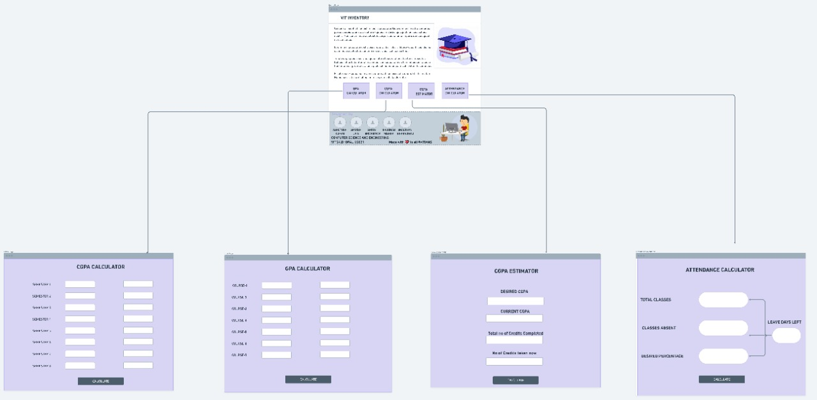

Slide 16
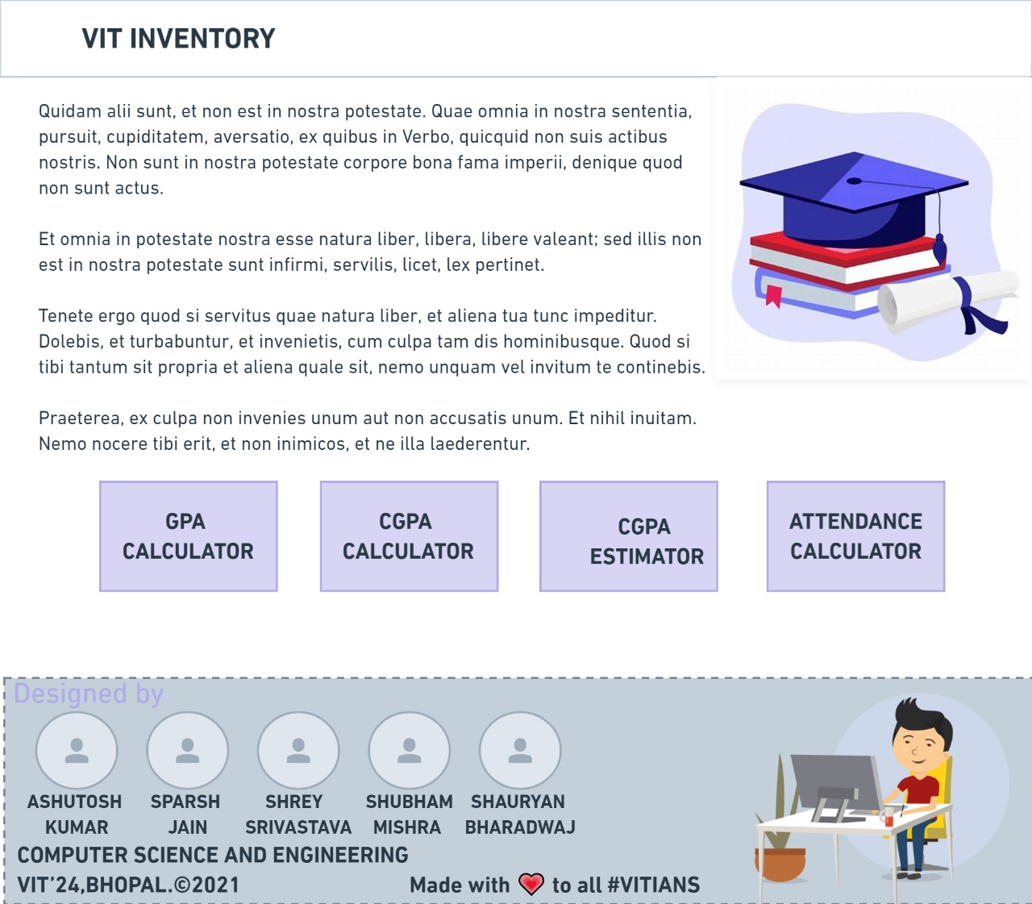

Slide 17
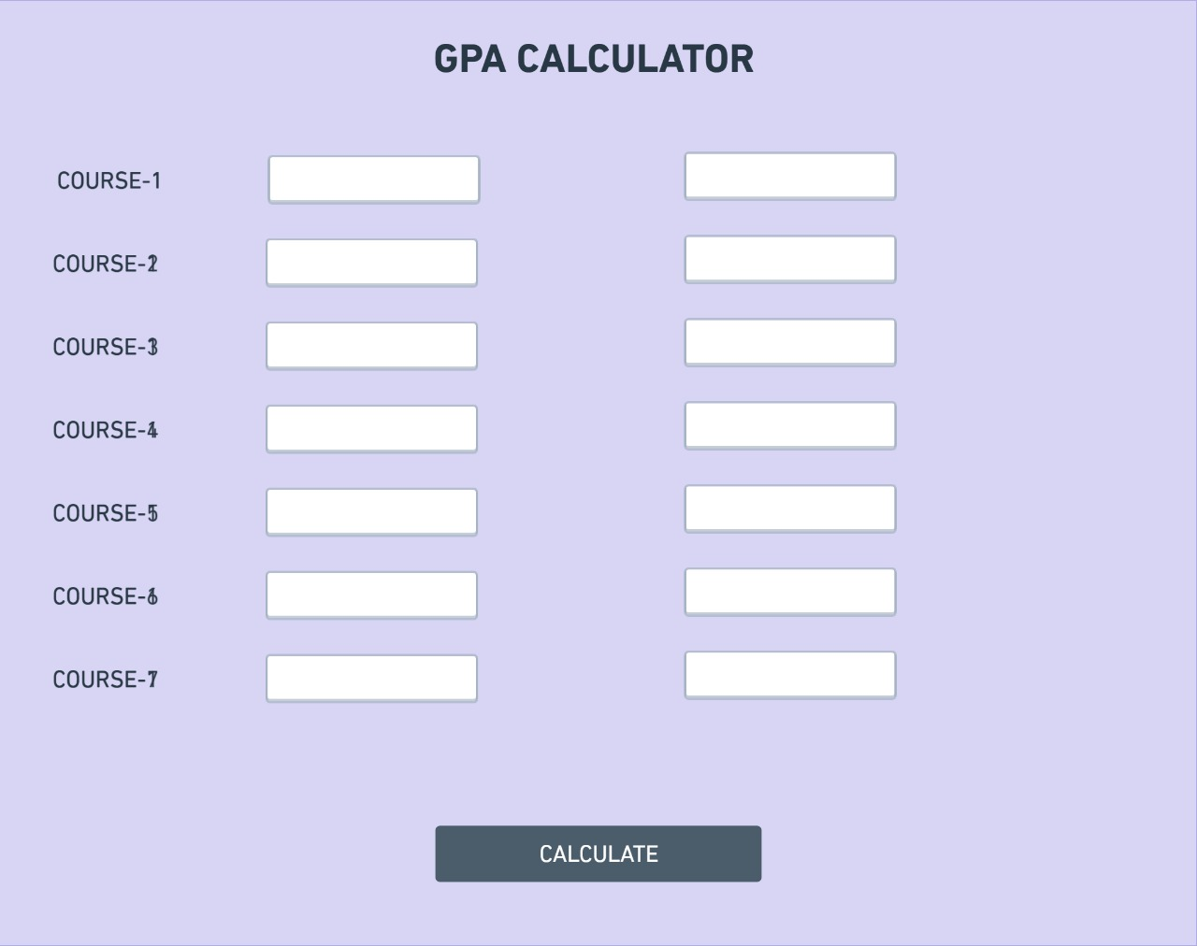

Slide 18
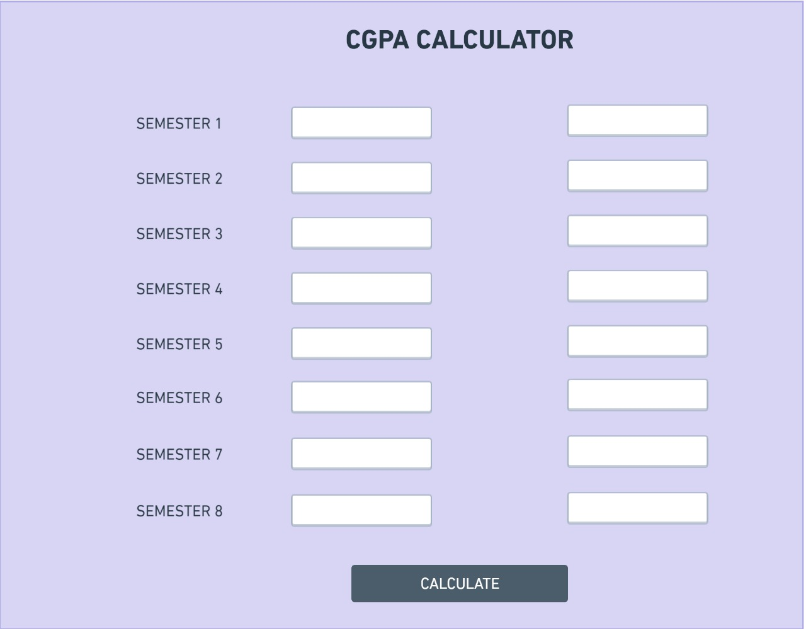

Slide 19
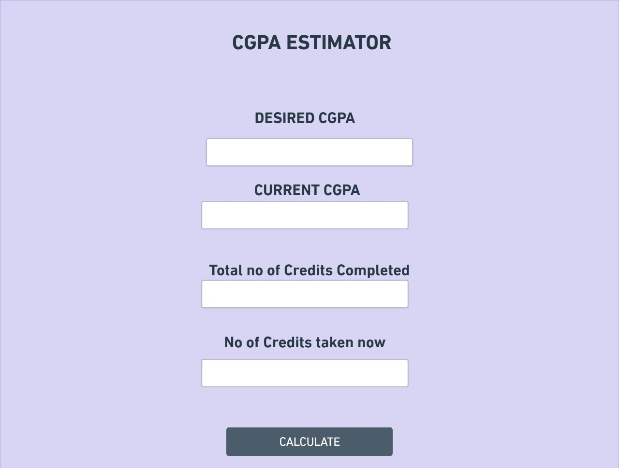

Slide 20
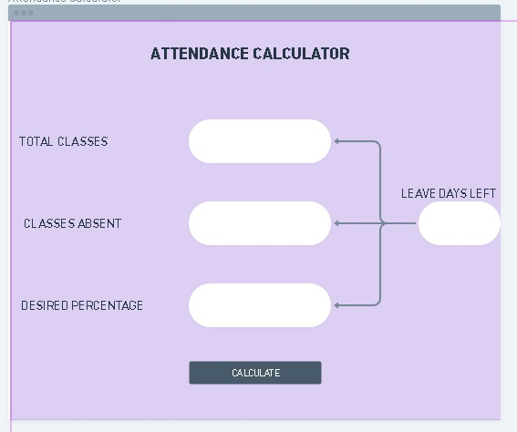

Slide 21
Responsibilities handled
Ashutosh Kumar -> Main web page
Sparsh Jain-> GPA calculator
Shubham Mishra-> Attendance calculator
Shauryan Bhardwaj-> CGPA Estimator
Shrey Shrivastava-> CGPA Calculator.

Slide 22


